Slide 1
FX Ambiguity and Safe‑Haven Reserve Allocation
Ruilin Yang, Haolin Liu, Xinye Lyu
Professor: James Adams
Financial Risk Management
November 14, 2025

Slide 2
Research Motivation
Central banks manage reserves under uncertainty
Ambiguity ≠ volatility (estimate uncertainty)
Safe-haven currencies (USD, CHF) typically gain in crises
Research question: Does higher FX ambiguity increase safe‑haven reserve shares?
Notes:
They are designed to store value during market stress and remain stable even when risky assets lose value.

Slide 3
Literature Review
The authors construct two market‐condition variables for FX: volatility and ambiguity
assemble carry‐trade portfolios
examine how these portfolios’ returns depend on the regime defined by high/low ambiguity and high/low volatility
visualizing the statistical results
Asano, Cai, and Sakemoto (2025) mainly demonstrates that FX ambiguity impacts the performance of currency carry trades involving the British pound and Japanese yen. They found that higher ambiguity will trigger to higher carry trade returns while the volatility is also high.

Slide 4
What is Ambiguity?
Unmeasurable uncertainty about the probability distribution
do not know the true probabilities (e.g., you know a coin is biased, but you don’t know the degree of bias).
Investors are uncertain not only about future returns, but also about the model or distribution that generates those returns
Izhakian (2020) formalizes this with the ℧² ambiguity index, which quantifies how irregular or unstable the probability distribution of returns is across time.

Slide 5
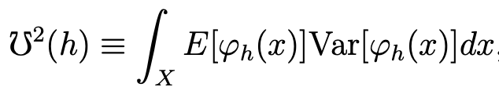
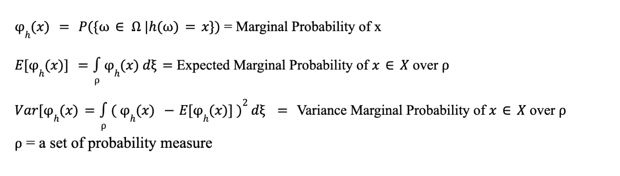
℧² = Theoretical Ambiguity Measure
The integral adds this uncertainty across all outcomes x
Model of uncertainty of the entire distribution, not return volatility
Based on continuous distributions
Problem of Estimation: Theoretical and Cannot be observed
Izhakian (2017, 2020) defines ambiguity as:
Notes:
℧² = the "true" formula of ambiguity (ideal world)
inverted ohm sign = mho
A measure of ambiguity about the distribution itself
Not volatility, Not risk
Purely measures the uncertainty about probabilities, not the uncertainty of returns
h(x) - random variable
Omega h(x) = marginal probability that the outcome equals x
E(h(x)) = expected probability of outcome
Var = Uncertainty about that probability (how unstable it is)
= The integral sums over all outcomes

Slide 6
We mainly focused on…
COFER reserve data, focusing on global FX reserves
Getting quarterly AMB by averaging monthly AMB.
Exploring the influence of ambiguity on FX reserves

Slide 7
Hypothesis
“ Higher foreign exchange (FX) ambiguity – distinct from volatility – induces central banks to tilt their reserve allocations toward “safe-haven” currencies such as USD and CHF ”

Slide 8

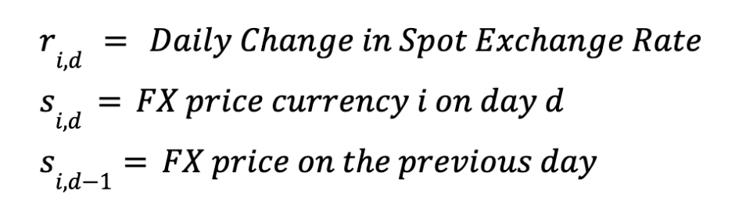
Data Description
Spot Exchange Rate using USD as base currency → monthly Ambiguity (AMBt)
COFER: Quarterly reserve composition data shares of CHF + USD.

Slide 9
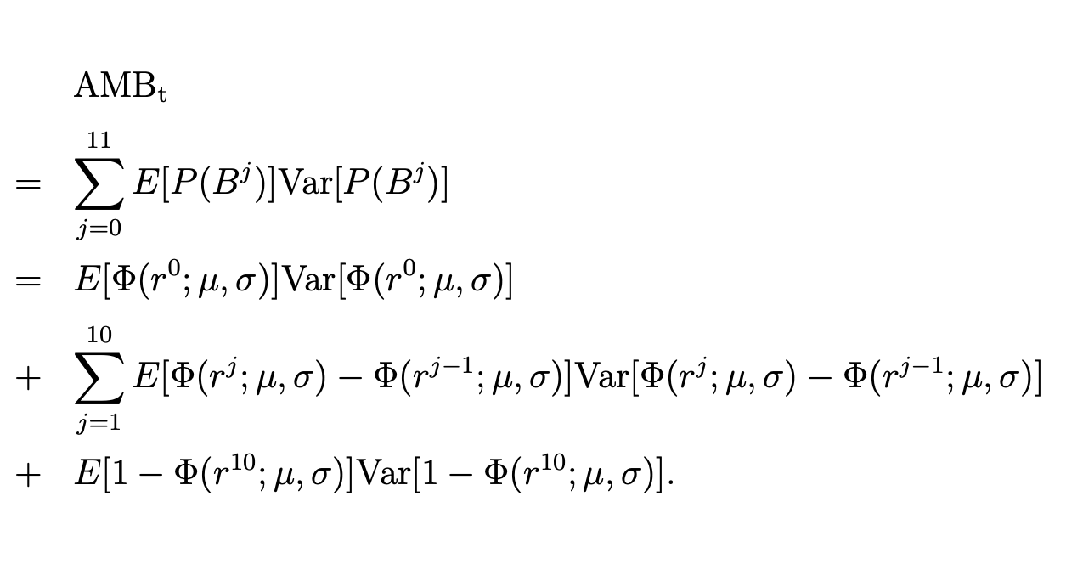
Measurable Ambiguity
AMBₜ is a discrete, monthly approximation of ℧².
AMBₜ tells you how unstable the FX return distribution is during month t.
Convert dailyFX return fluctuations into a single monthly ambiguity score
Assumes Cumulative Normal Distribution Function for all returns
Notes:
Bin = What fraction of the day’s return distribution falls in each bin.
To measure how unstable the FX return distribution is over a month — i.e., how much the shape of the return distribution changes day to day.
This instability = ambiguity.

Slide 10

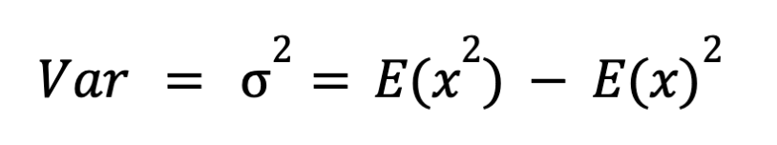
Measurable Market Ambiguity
Asano Modified from previous Monthly AMBt model to solve for a general market Ambiguity.
Where:
μ = arithmetic mean of all Spot rates on day d
σ = uncertainty of combined spot rates on day d

Slide 11
Data
FX EXCHANGE RATE
COFER QUARTERLY RESERVE HOLD
USDCNY
USDAUD
USDCNY
USDGBP
USDEUR
USDCAD
USDNZD
USDNOK
USDSEK
CHF
USD

Slide 12
Method
Compute monthly AMBt
Convert monthly AMBt into quarterly AMBt
Merge with quarterly FX reserves
Visualize the trend over the past ten years
FInd correlation between AMBt and Reverse Holding

Slide 13
Results
FX Ambiguity rises sharply during market stress, while reserve shares adjust only slowly.
Negative contemporaneous correlations:
AMB vs USD share ≈ –0.35
AMB vs CHF share ≈ –0.14
AMB vs (USD+CHF) safe-haven share ≈ –0.36
Lagged regressions show no significant short-term effect — central banks do not rebalance reserves immediately after ambiguity spikes.
Pattern suggests delayed or nonlinear adjustment: policy inertia + multi-quarter allocation cycles.
Results confirm distinct time scales between market uncertainty and official reserve behavior.

Slide 14
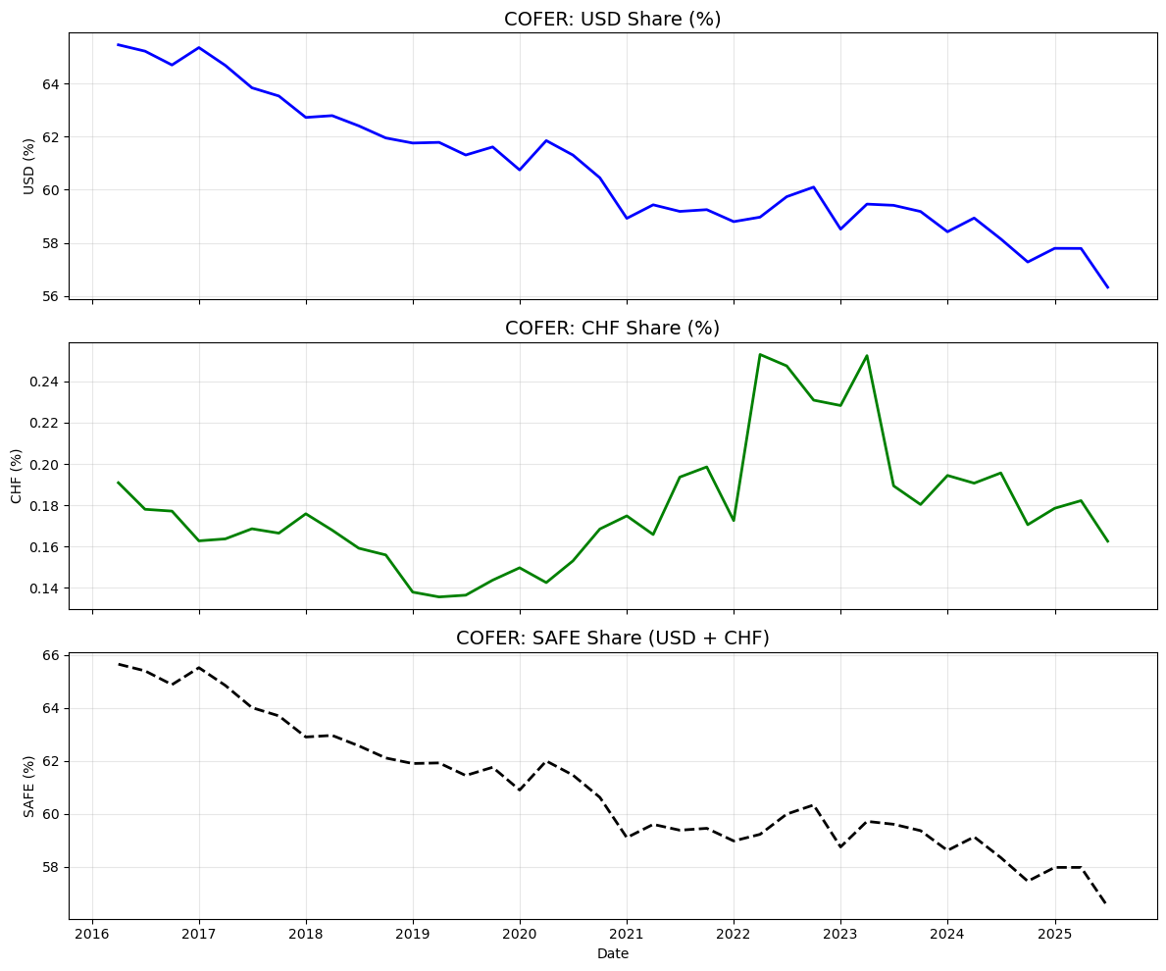
COFER: Reserve Holding (2016Q1 - 2025Q3)
Use two distinct colors of show USD and CHF holding

Slide 15
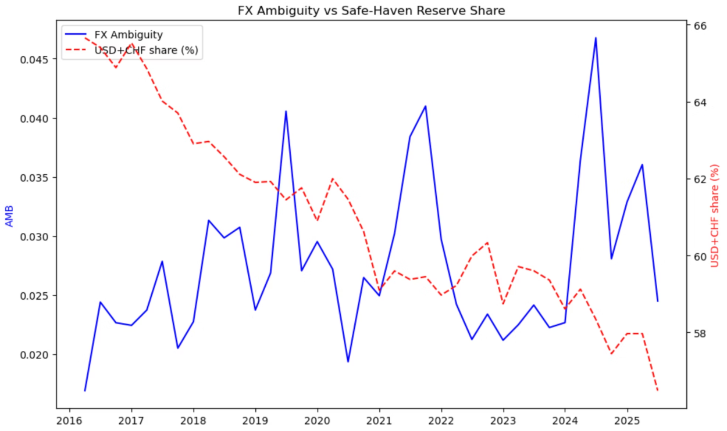
Market Ambiguity

Slide 16
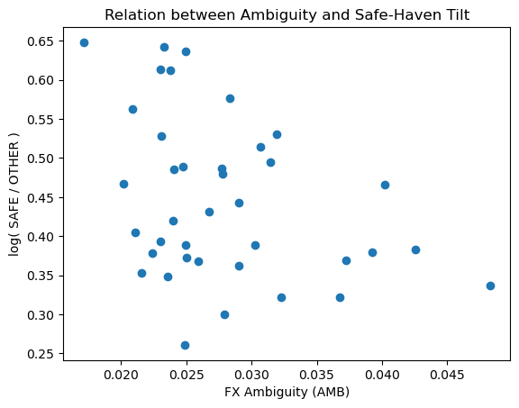
ScatterPlot

Slide 17
Conclusion
Contemporaneous correlation is modestly negative (≈ –0.35), indicating that ambiguity spikes do not immediately lead to higher USD/CHF reserve shares.
USD remains the dominant safe-haven reserve, while CHF reacts mainly during stress episodes, giving it a weaker structural relationship with ambiguity.
Timing matters — ambiguity shocks do not align with reserve changes, suggesting lagged or persistent ambiguity may drive central-bank decisions. • The combined dataset (FX + COFER) is consistent and ready for formal lagged regressions with controls (VIX, DXY, rates) to identify causal channels.

Slide 18
Thank You

